Slide 1
PROJECT 2:
YOUR HOUSE, YOUR FUTURE:
MAKING INFORMED REAL ESTATE DECISIONS
TEAM: DATA-NINE-NINE
Ming Fatt, Jasmine, Jin Jin, Wen Xi, Willson

Slide 2



DID YOU KNOW?
Expected Prices Increase of HDB
2%- 8% for year 2023
Whereas Price Hike of HDB
10.4% for year 2021 12.7% for year 2022
Source: https://www.channelnewsasia.com/singapore/cooling-measures-singapore-hdb-resale-prices-towns-property-map-3499961#:~:text=Analysts%20expect%20a%20one%2Ddigit,12.7%20per%20cent%20in%202021.

Slide 3

Problem Statement
The general public may not be well-equipped with the information needed to aid their Real Estate decision making process. Some of the common questions they might have are
(1) What are the available options given my current budget?
(2) Which flat type and where can I afford?
(3) What price should I set when I sell my flat?
(4) How to market my flat to increase its selling price?
General public

Slide 4


FRET NOT!
REAL ESTATE START-UP COMPANY,
DATA NINE-NINE IS HERE TO HELP!
With our state-of-the-art data driven HDB resale price prediction model, your real estate issues shall be a thing of the past.

Slide 5

FLOW OF MODEL BUILDING PROCESS
Understanding the model building process

Slide 6
OUR PROCESS IS EASY
Define the problem
Gather data
Explore data
Identify market need
Serve the need
Through Automated valuation process
Gather the necessary raw data
Data cleaning works
Feature Engineering
Study correlation between features
Verify reliability of correlation
Select features for our model

Slide 7
OUR PROCESS IS EASY
Produce a model with the data
Evaluate the model
Providing recommendation to the problem with the model
Construct Model
Linear, Ridge, and Lasso Regression models
Optimise models
Evaluate models with Cross Validation, RMSE and R Squared
Best model among the 9 are deployed
Made customised Predictions
Data-Driven Recommendations will be provided

Slide 8
EXPLORATORY DATA ANALYSIS PROCESS
Data Janitorial Work

Slide 9
Datasets used contained
150,634
77
Mar ‘12 - Apr ‘21
HDB flat resale transaction
Features
Duration of dataset

Slide 10
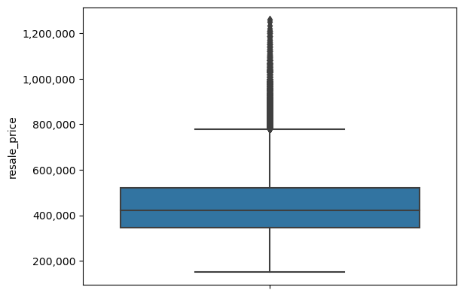
Overview of sale pricing
1
1
Most expensive sale
$1,258,000
5 room flat in Central Area (in 2020)
2
Avg sale price
$449,162
2
3
Cheapest sale
$150,000
2 room flat in Toa Payoh (2020) & Geylang (in 2019)
3

Slide 11
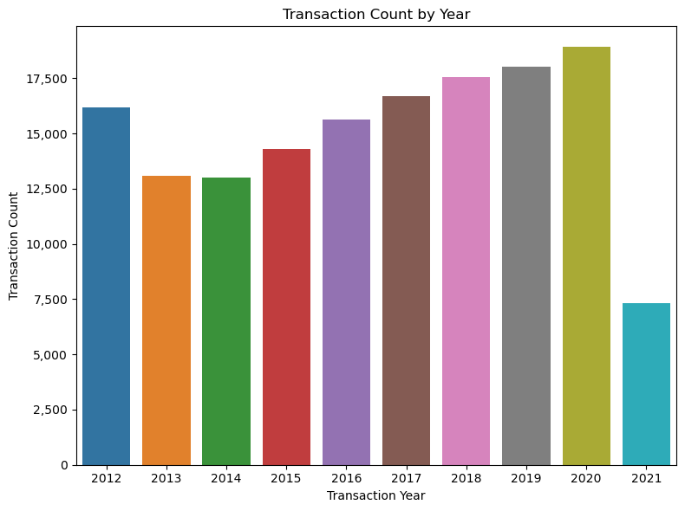
Exploratory Data Analysis
The dip of transaction count of HDB resale flats in the year of 2013 & 2014 is noted, and may be related to cooling measures introduced in 2013*.
2021 data is only up till Apr; if pro-rated for 2021 (entire year) it is on track to be higher than in 2020
* https://stackedhomes.com/editorial/singapore-cooling-measures-history

Slide 12
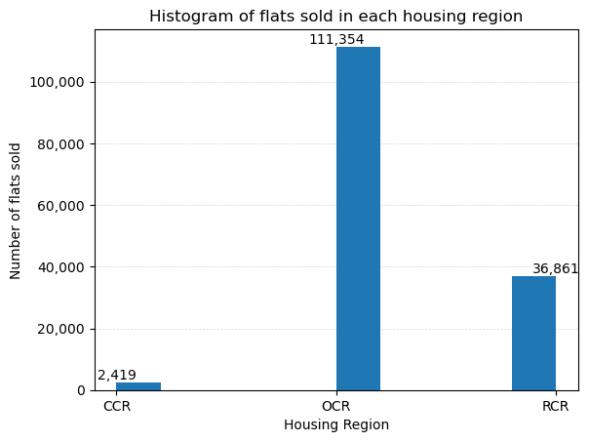
Exploratory Data Analysis
Legend*:
CCR = Core Central Region
RCR = Rest of Central Region
OCR = Outside Central Region
Most houses sold were in the OCR
(Outside Central Region)
https://www.ura.gov.sg/-/media/Corporate/Property/REALIS/realis-maps/map_ccr.pdf

Slide 13
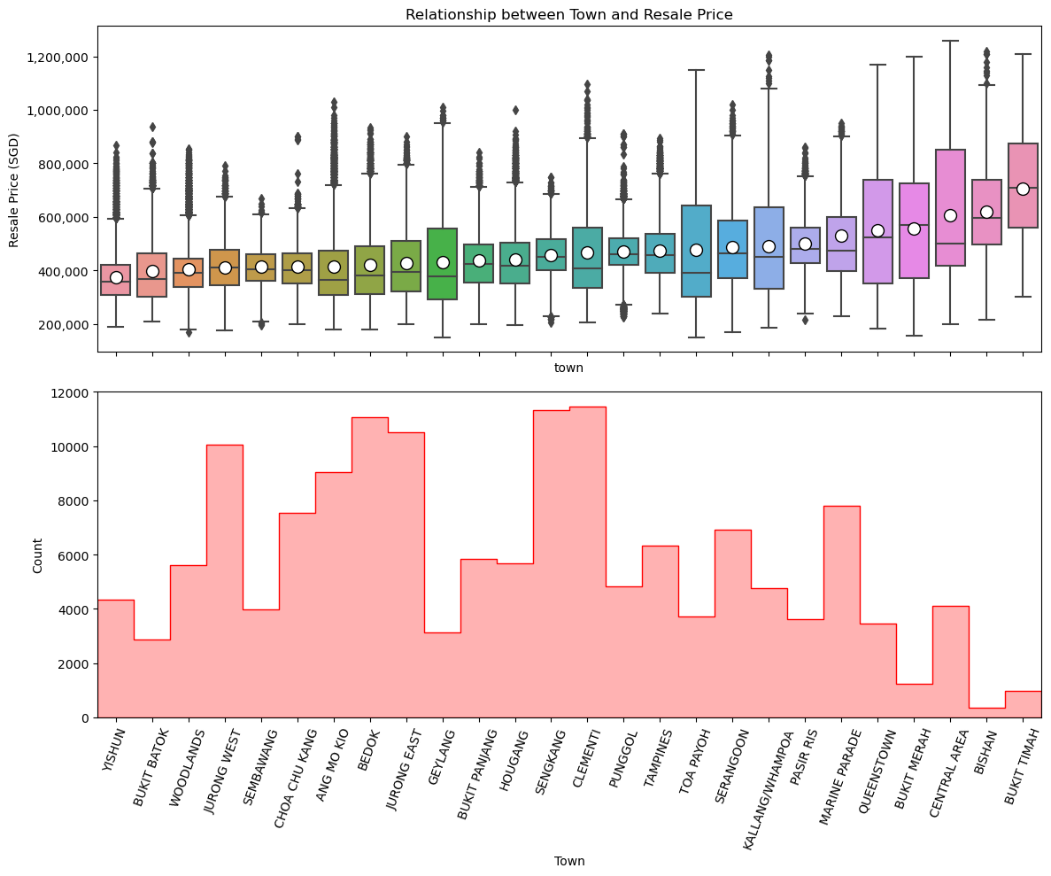
Exploratory Data Analysis
Most houses sold from 2012 to 2021 are in the OCR region, not so much within central region
Towns with the more expensive resale prices had the lowest number of transactions
o: represents mean resale price

Slide 14
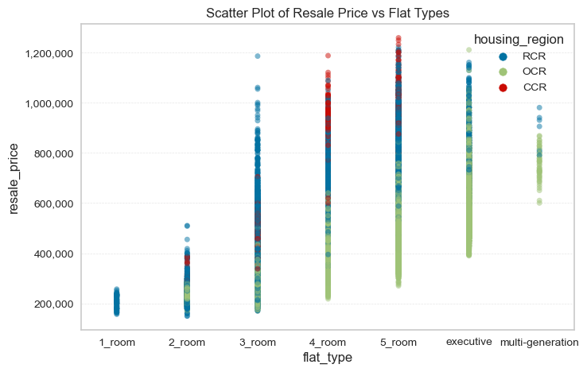
Exploratory Data Analysis
Legend:
CCR = Core Central Region
OCR = Outside Central Region
RCR = Rest of Central Region
CCR: Consistently more expensive
RCR: Middleground
OCR: Generally the least expensive

Slide 15
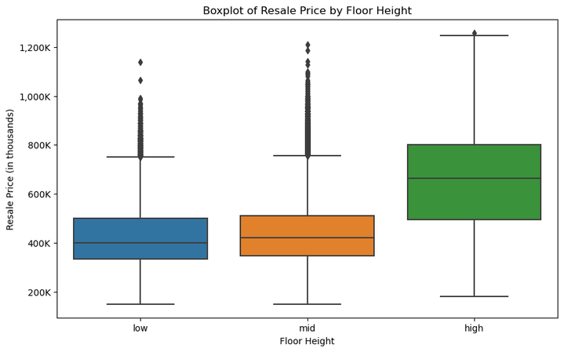
Exploratory Data Analysis
Low Floor:
Below 6 storey
Less than ⅔ of low rise building
Less than ⅓ of mid rise building
Mid Floor :
Between storey 7 - 18
Above ⅓ of mid rise building
Above ⅔ of low rise building
High Floor:
Above storey 18

Slide 16
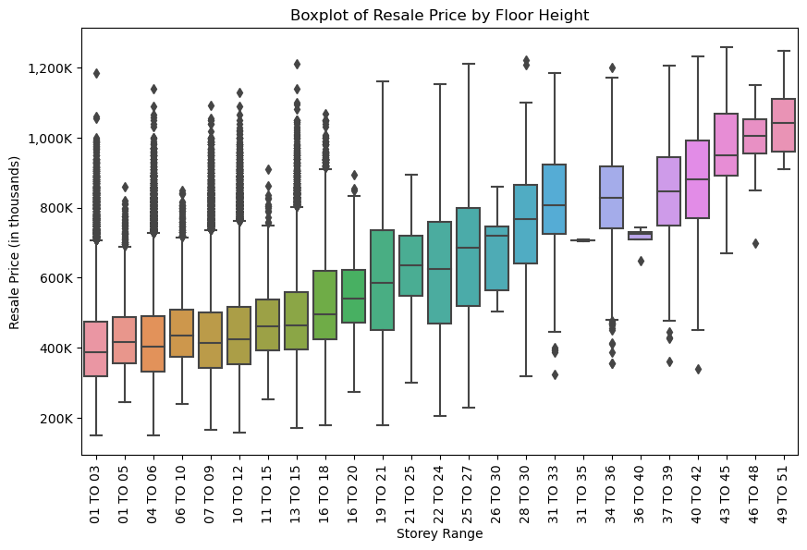
Exploratory Data Analysis
There’s a general uptrend on the resale price as the storey range goes up

Slide 17
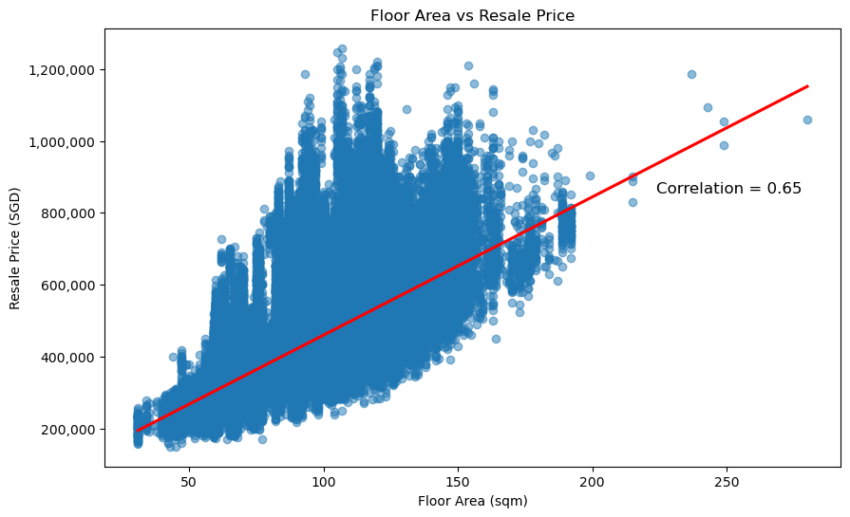
Exploratory Data Analysis
Floor Area of the HDB unit seems to have a strong positive correlation to the resale price of the HDB unit.

Slide 18
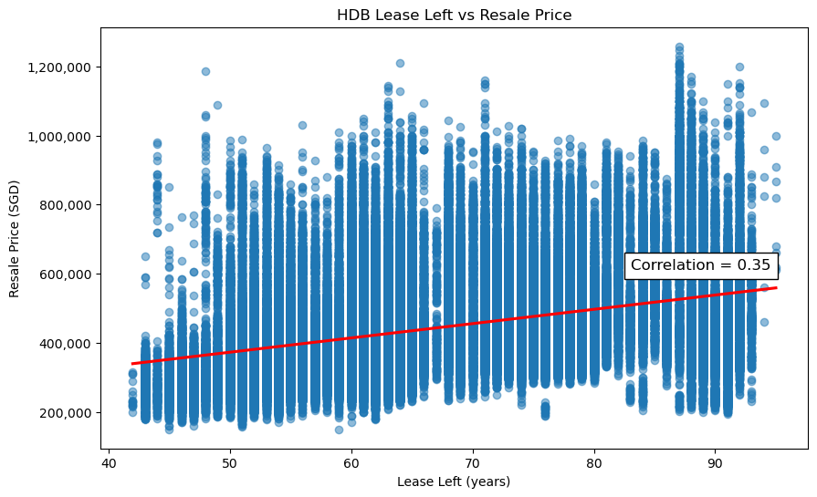
Exploratory Data Analysis
The more years left in the lease of the HDB unit is correlated to how high of a resale price the HDB unit is able to fetch.

Slide 19
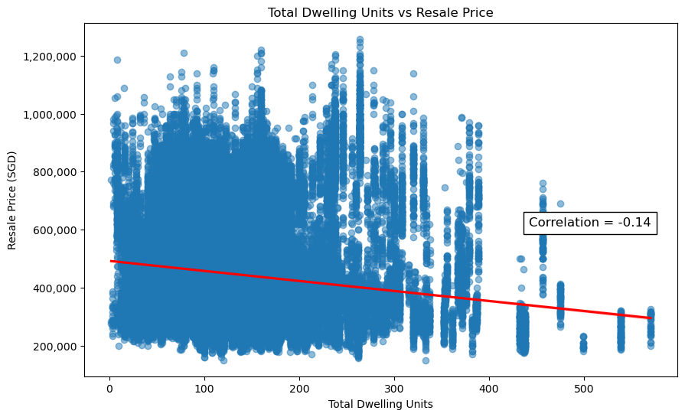
Exploratory Data Analysis
Total dwelling units in a HDB block is not observed to have a strong correlation with the resale price.

Slide 20
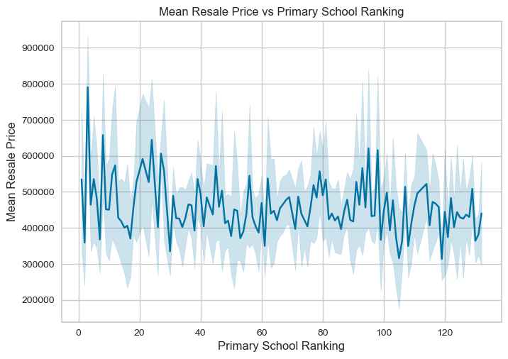
Exploratory Data Analysis
Nearby primary school ranking does not seem to have an obvious influence over the resale price of a HDB unit.
This observation is consistent with the findings of other sources.
Source: https://dollarsandsense.sg/hdb-property-prices-near-popular-primary-schools-really-cost/

Slide 21
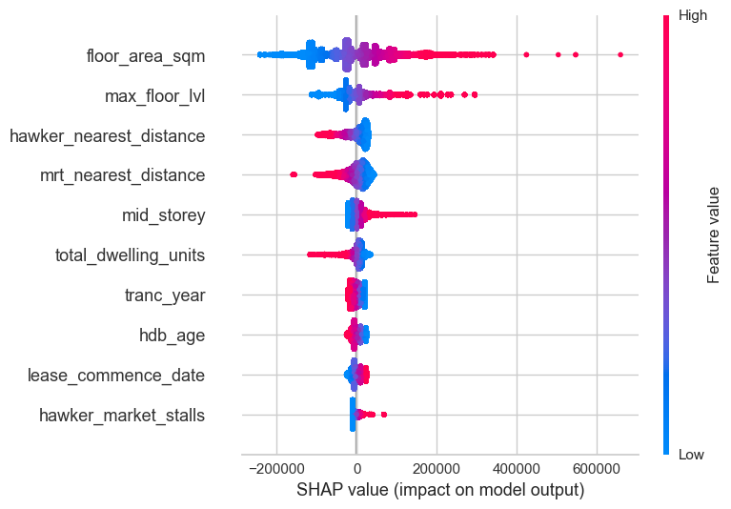
Exploratory Data Analysis
Features that were found to have the greatest impact on the model output .

Slide 22
LINEAR REGRESSION MODEL
Building a “linear guideline” for making predictions of future prices of HDB units.

Slide 23

Regression Model Results
Model 1 performed better on unseen data set
Model | R² (train) | R² (test) | RMSE | RMSE (Unseen data, kaggle)
Baseline | 0.8638 | 0.8610 | 52,965.62 | -
1 | 0.8911 | 0.8904 | 47,162.25 | 47,149.78
2 | 0.9147 | 0.9137 | 41,837.78 | 54,155.30
3 | 0.8927 | 0.8920 | 46,806.20 | 55,781.83
Notes:
In order to know how well our model is performing, we need some measurements to verify
R-squared score, also known as the Coefficient of Determination measures how well our model fits the set of data.
1 is max, 0 min, The higher the R square, the better the model is fitting
Tested on both training & testing data as a comparison to identify if the model is over-fitting.
However, it's important to note that the R-squared score alone doesn't tell us if the model is good or bad. It only measures the goodness of fit.
RMSE or The root mean squared error is a measure that helps us understand how well a model's predictions match the actual observed values. In short, tells you, on average, how much the predicted prices differ from the actual prices.
Even thou Model 2 & 3 performed better on the available dataset, Model 1 still performed the better on unseen data hence was selected as the final model.
Hence the prediction is not stable (over fitting)

Slide 24
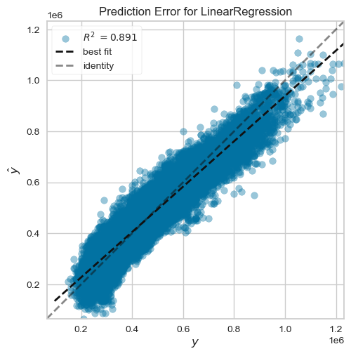
Linear Regression Model
Prediction error plot shows the actual targets from the dataset against the predicted values generated by our model
Notes:
The prediction error plot is a way to compare the actual values vs the values predicted by our model.
If the model is perfect, all the points would fall exactly on a straight line.
However, in reality, there are bound to be differences between predictions and actual value.
As a famous statistician (George Box) once said, “All models are wrong, but some are useful”. So in reality, no ML model can predict with a 100% accuracy
Hence the prediction error plot helps us see how close or far off our predictions are from the actual values.
And as we can see our model perform very well with most points gathering around the middle line

Slide 25
Linear Regression: Feature Selection
Model | Feature Selection Description
Baseline | Baseline model runs with all numeric features Used as a baseline to evaluate model performance
1 | Feature selection based on domain knowledge Elements that are known to affect housing prices
2 | The features selection are based on features correlation Feature engineering of region against flat types Popularity ranking of primary schools Availability of amenities
3 | Feature selection based on model 1 features and Feature importance from previous models.
Notes:
Elements that affect housing prices
Which town
How high the storey
Flat type
Distance from mrt, hawker, mall, etc
Look at features with high correlation with the target
Ended up quite alot of features but didn’t perform as expected.

Slide 26
PRODUCT DEMONSTRATION
Live demonstration of your property valuation

Slide 27
RECOMMENDATION & KEY INSIGHTS
So what’s the gist of it?

Slide 28
Recommendations
Buyer
Know your available options given your budget
Buyers should be able to make an informed decision that fits their budget.
Prioritize and personalize your wants
Buyers are recommended to straighten out their priority and decide on the factors that fits their needs most.
Quality home with comfortable price
Seller
Appraise your property value based on market valuation
Sellers are recommended to at least have some understanding of the market resale price of their respective units.
Pivot your selling strategies
Sellers are recommended to be ready to switch up with their selling strategies at any given time due to market volatility.
Match your property’s unique selling points to the right buyers

Slide 29
1 Minute
89.1%
11 X-Factors
To have an estimated price for your dream house
Prediction accuracy
Focus on the factors that matters

Slide 30
KEY LIMITATIONS
If only we had more time and resource.

Slide 31
Key Limitations
Limitation of data
Data collected is only up to 2021
Modelling is limited to only Linear Regression
Opportunity to utilize more sophisticated model in the future for better prediction.
Lack of info on the existing condition of the sold units
Collinearity does not imply causation

Slide 32
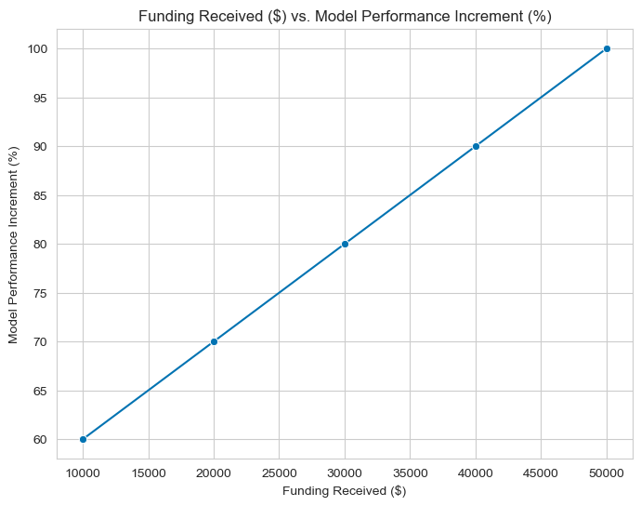
Key Limitations (Joke)
Funding
Severe lack of funding is making it challenging to carry out further refinement works to increase the model performance.
Disclaimer: This is a joke slide

Slide 33
Your House,
Your Future
Make your real estate plans with technology of future

Slide 34
THANK
YOU!

Slide 35
BACK-UP SLIDES / ANNEX
Extra cheese

Slide 36
Linear Regression Model
Model 1 Features:
Target (y-axis): resale_price
X(axis):
1. `town` (cat)
2. `storey_range` (cat)
3. `full_flat_type` (cat)
4. `pri_sch_name` (cat)
5. floor_area_sqm
6. lease_commence_date
7. mrt_nearest_distance
8. hawker_nearest_distance
9. mall_nearest_distance
10. pri_sch_nearest_distance
11. sec_sch_nearest_dist

Slide 37
Features
Train.csv features: 78
Dropped: id, price_per_sqft, floor_area_sqft, resale_price (which is target)
Added: pop_ranking, pop_ranking_2cat, housing_region

Slide 38
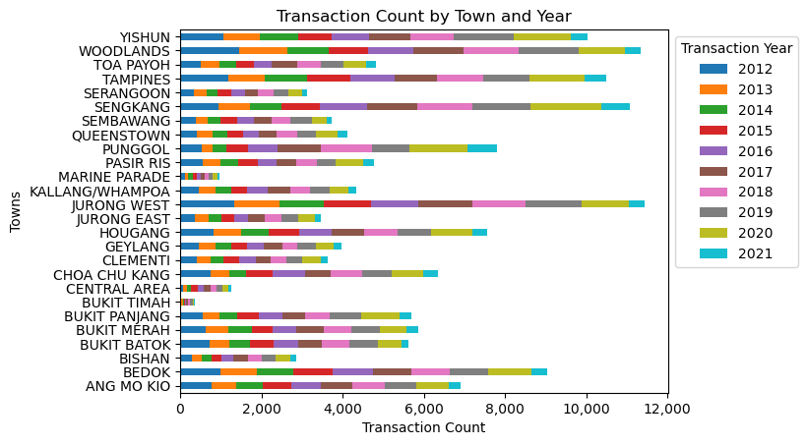
Exploratory Data Analysis

Slide 39
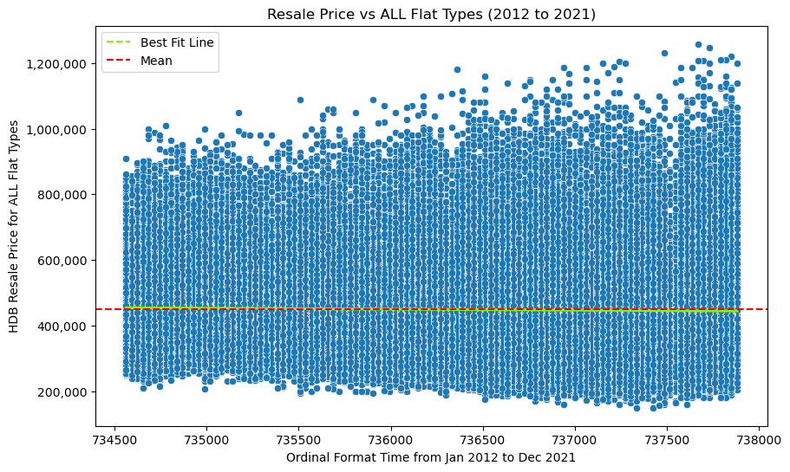
Exploratory Data Analysis
Note:
Progression of years is found to not have much effect on the resale prices of HDB units

Slide 40
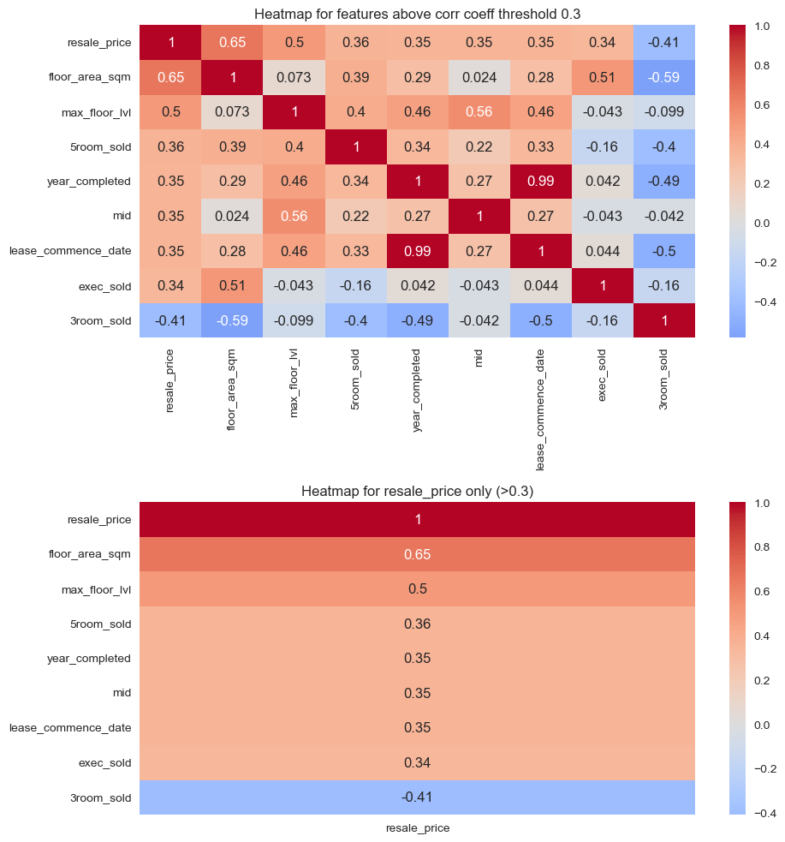
Exploratory Data Analysis
Note:
Heatmap of correlation coefficient of features to resale_price.

Slide 41
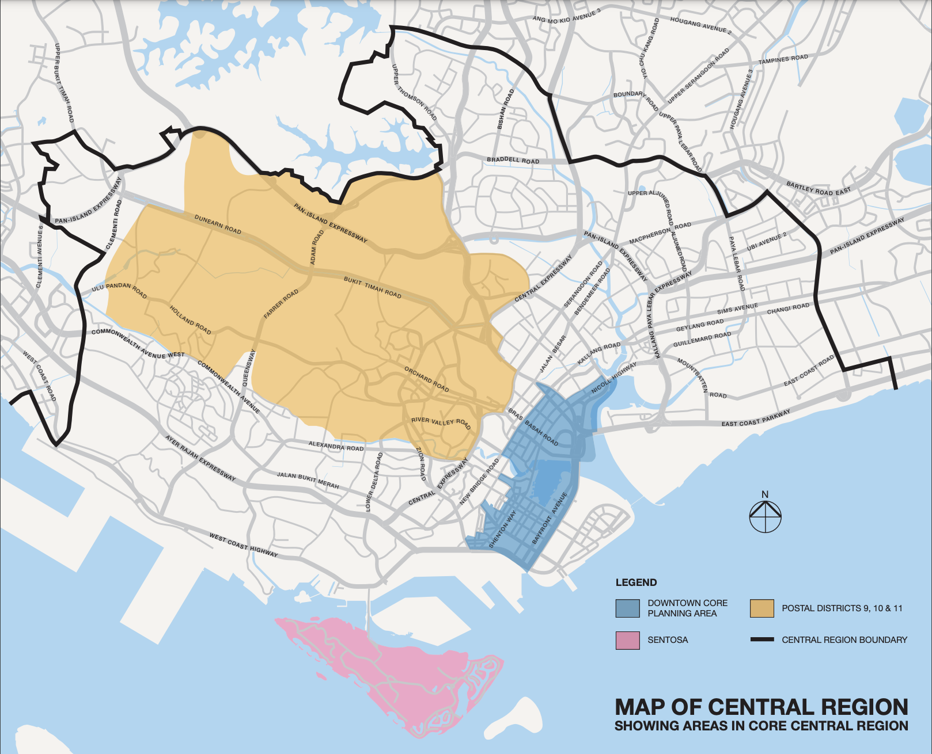
Housing Regions: CCR, RCR, OCR
URA Map from:
https://www.ura.gov.sg/-/media/Corporate/Property/REALIS/realis-maps/map_ccr.pdf

Slide 42
Postal Sector
https://www.mingproperty.sg/singapore-district-code/

Slide 43
Regression Model Results
Linear Regression Model | R² (train) | R² (test) | RMSE | RMSE (Unseen data, kaggle)
Baseline | 0.8638 | 0.8617 | 52,965.62
1 | 0.8911 | 0.8904 | 47,162.25 | 47,149.78
2 | 0.9147 | 0.9137 | 41,837.78 | 47,509.99
3 | 0.8917 | 0.8920 | 46,806.20 | 55,781.83

Slide 44
Regression Model Results
Ridge Regression Model | R² (train) | R² (test) | RMSE | RMSE (Unseen data, kaggle)
Baseline | 0.8638 | 0.8617 | 52,965.61
1 | 0.8911 | 0.8903 | 47,163.40 | 47,149.78
2 | 0.9146 | 0.9136 | 41,854.66 | 47,509.99
3 | 0.8927 | 0.8920 | 46,805.96 | 55,781.83

Slide 45
Regression Model Results
Lasso Regression Model | R² (train) | R² (test) | RMSE | RMSE (Unseen data, kaggle)
Baseline | 0.8631 | 0.8610 | 53,105.47
1 | 0.5761 | 0.5751 | 92,861.14 | 47,149.78
2 | 0.7071 | 0.7046 | 77,422.44 | 47,509.99
3 | 0.8920 | 0.8914 | 46,927.46 | 55,781.83

Slide 46
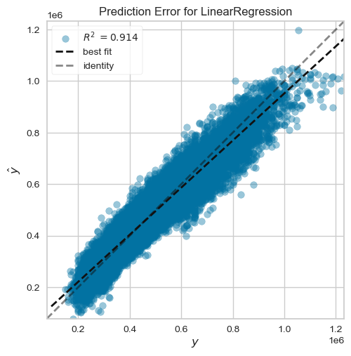
Linear Regression Model
Note:
Model 2

